Slide 1

Welcome to Sabbath School
Illustration by Jo Card. Copyright © 2024 General Conference Corporation® of Seventh-day Adventists.

Slide 2

EARLY ARRIVALS
EARLY
ARRIVALS

Slide 3

Books of the Bible
EARLY ARRIVALS
EARLY
ARRIVALS

Slide 4
Welcome to Sabbath School
Illustration by Jo Card. Copyright © 2024 General Conference Corporation® of Seventh-day Adventists.

Slide 5

Child of the King
OPENING ACTIVITIES
How can it be,
That God chooses me
And calls me His own?
I’m a child of the King.
How can it be,
That God chooses me
And calls me His own?
I’m a child of the King.
(Continued on next slide)

Slide 6
Child of the King
OPENING ACTIVITIES
I was made for more
Than to strive for worldly things,
For heaven is my home.
I’m a child of the King.
I was made for more
Than to strive for worldly things,
For heaven is my home.
I’m a child, a child of the King.
(Continued on next slide)

Slide 7
Child of the King
OPENING ACTIVITIES
How can it be,
That God chooses me
And calls me His own?
I’m a child of the King.
How can it be,
That God chooses me
And calls me His own?
I’m a child of the King.
(Continued on next slide)

Slide 8
Child of the King
OPENING ACTIVITIES
I was made for more
Than to strive for worldly things,
For heaven is my home.
I’m a child of the King.
I was made for more
Than to strive for worldly things,
For heaven is my home.
I’m a child, I’m a child of the King.
"Child of the King" by Kimberly Houliston, copyright © 2007 Abide Family Ministries. Used by permission.

Slide 9
God Loves You
OPENING ACTIVITIES
When you feel small and scared,
When you feel alone
And like no one cares,
When life is hard and seems unfair, Remember this one truth:
God loves you.
(Continued on next slide)

Slide 10
God Loves You
OPENING ACTIVITIES
He is your faithful friend.
God loves you,
And His mercy never ends.
He sees you and He knows you,
And all that you go through.
So remember this one truth,
God loves you.
(Continued on next slide)

Slide 11
God Loves You
OPENING ACTIVITIES
When you feel small and scared,
When you feel alone
And like no one cares,
When life is hard and seems unfair, Remember this one truth:
God loves you.
(Continued on next slide)

Slide 12
God Loves You
OPENING ACTIVITIES
He is your faithful friend.
God loves you,
And His mercy never ends.
He sees you and He knows you,
And all that you go through.
So remember this one truth,
God loves you.
”God Loves You" by Rosie Smith, copyright © 2026 General Conference Corporation® of Seventh-day Adventists.

Slide 13
Sabbath Song
OPENING ACTIVITIES
He made us, He saved us,
He’s coming back to take us home.
(Repeat two times)
Jesus, You are welcome in this place.
Father, You are welcome in this space.
Holy Spirit, fill our hearts with grace.
In this palace of time and space.
(Repeat above)
In this palace of time and space.
"Sabbath Song" by Alexandria and Leighton Heise, copyright © 2020, Alexandria and Leighton Heise. Used by permission.

Slide 14
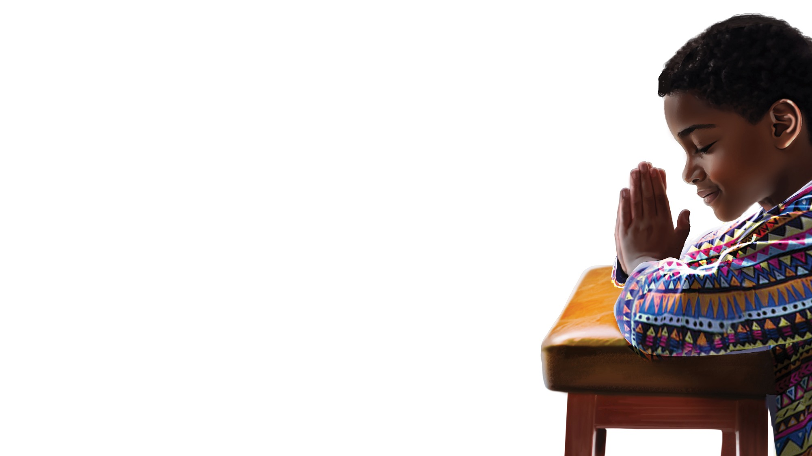
PRAYER
PRAYER

Slide 15
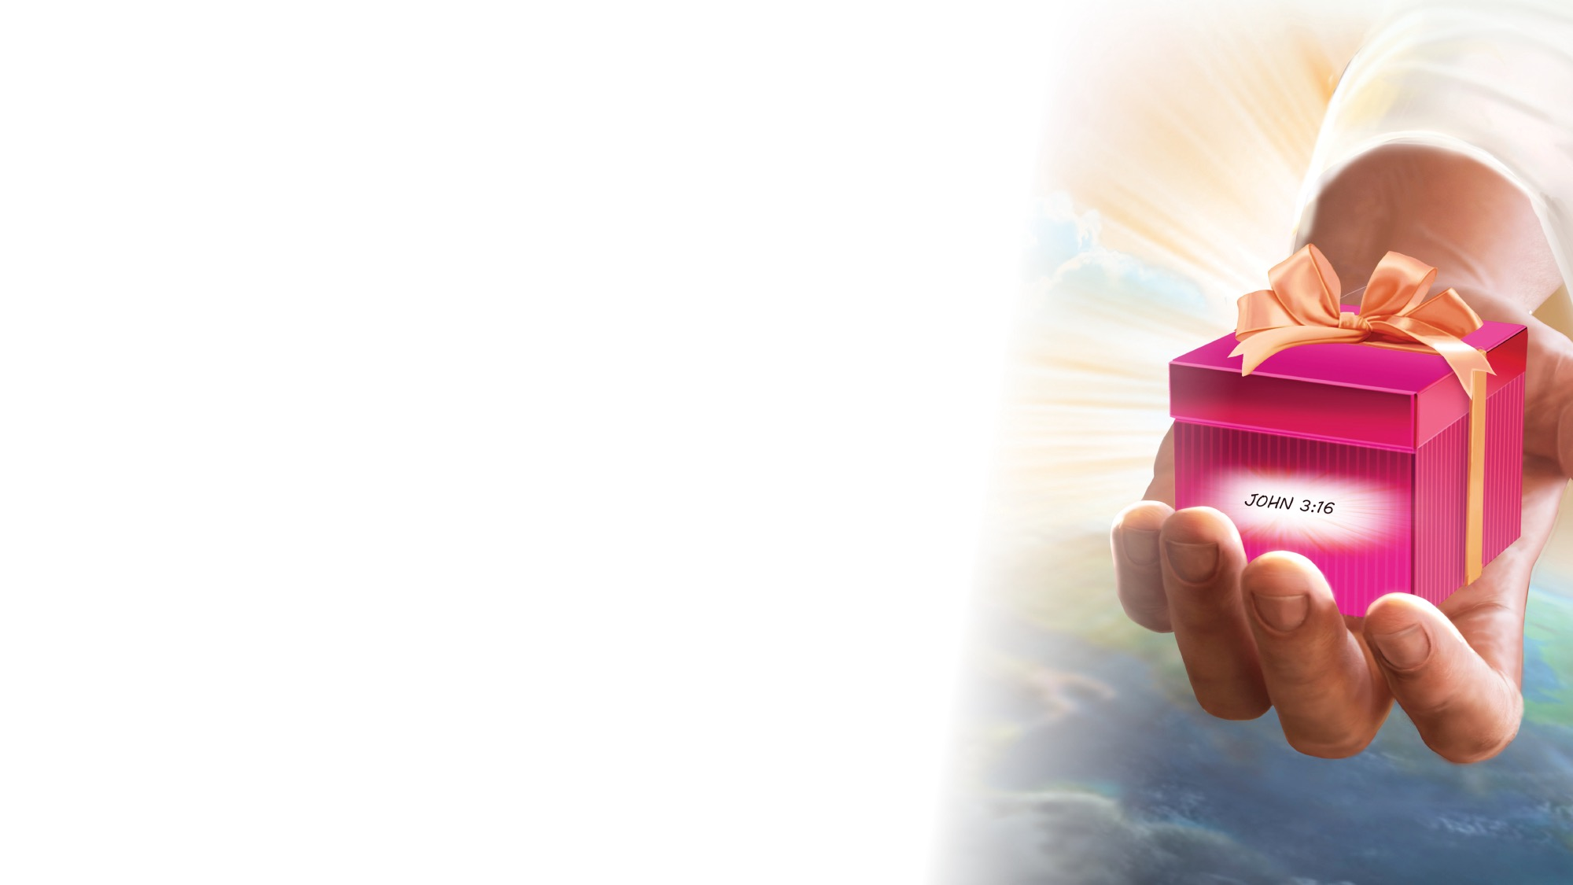
OFFERING

Slide 16

Thank You, Jesus
OPENING ACTIVITIES
Thank you, Jesus
For providing all my needs.
I want to give a little back
Of what you’ve given me.
Please bless our
Sabbath School offering.
May it bring You glory
And help others in need.
(Repeat above)
May it bring You glory
And help others in need.
"Thank You, Jesus" by Rosie Smith, copyright © 2024 General Conference Corporation® of Seventh-day Adventists.

Slide 17
MISSION
FAST FACT &
OFFERING
CHART

Slide 18
Visitor Song
OPENING ACTIVITIES
We have a new friend
With us today.
We have a new friend.
Let’s smile and wave.
We welcome you to Sabbath School.
We’re glad you came.
We welcome you,
And hope to see you again. (x2)
“Visitor Song” by Rosie Smith. Copyright © 2025 General Conference Corporation® of Seventh-day Adventists.

Slide 19
Happy Birthday
OPENING ACTIVITIES
Happy birthday, happy birthday,
Happy birthday to you.
Jesus loves you dear ___________.
Happy birthday to you.
(Repeat above)
“Happy Birthday” by Janet Sage, copyright © 2001 North American Division Corporation of Seventh-day Adventists. From Little Voices Praise Him, #39. Used by permission.

Slide 20

FOCUS
ACTIVITIES

Slide 21
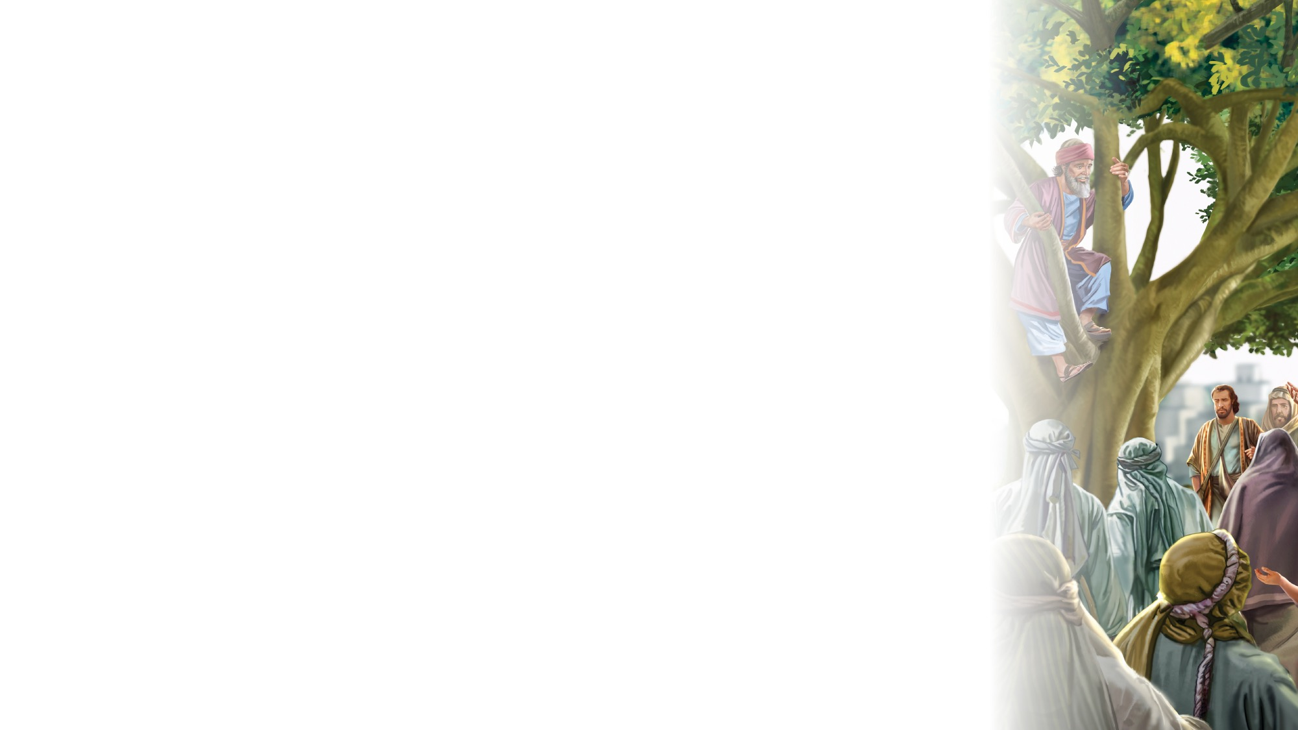
BIG IDEA
Jesus sees potential for good in everyone.

Slide 22

BIBLE
STORY

Slide 23
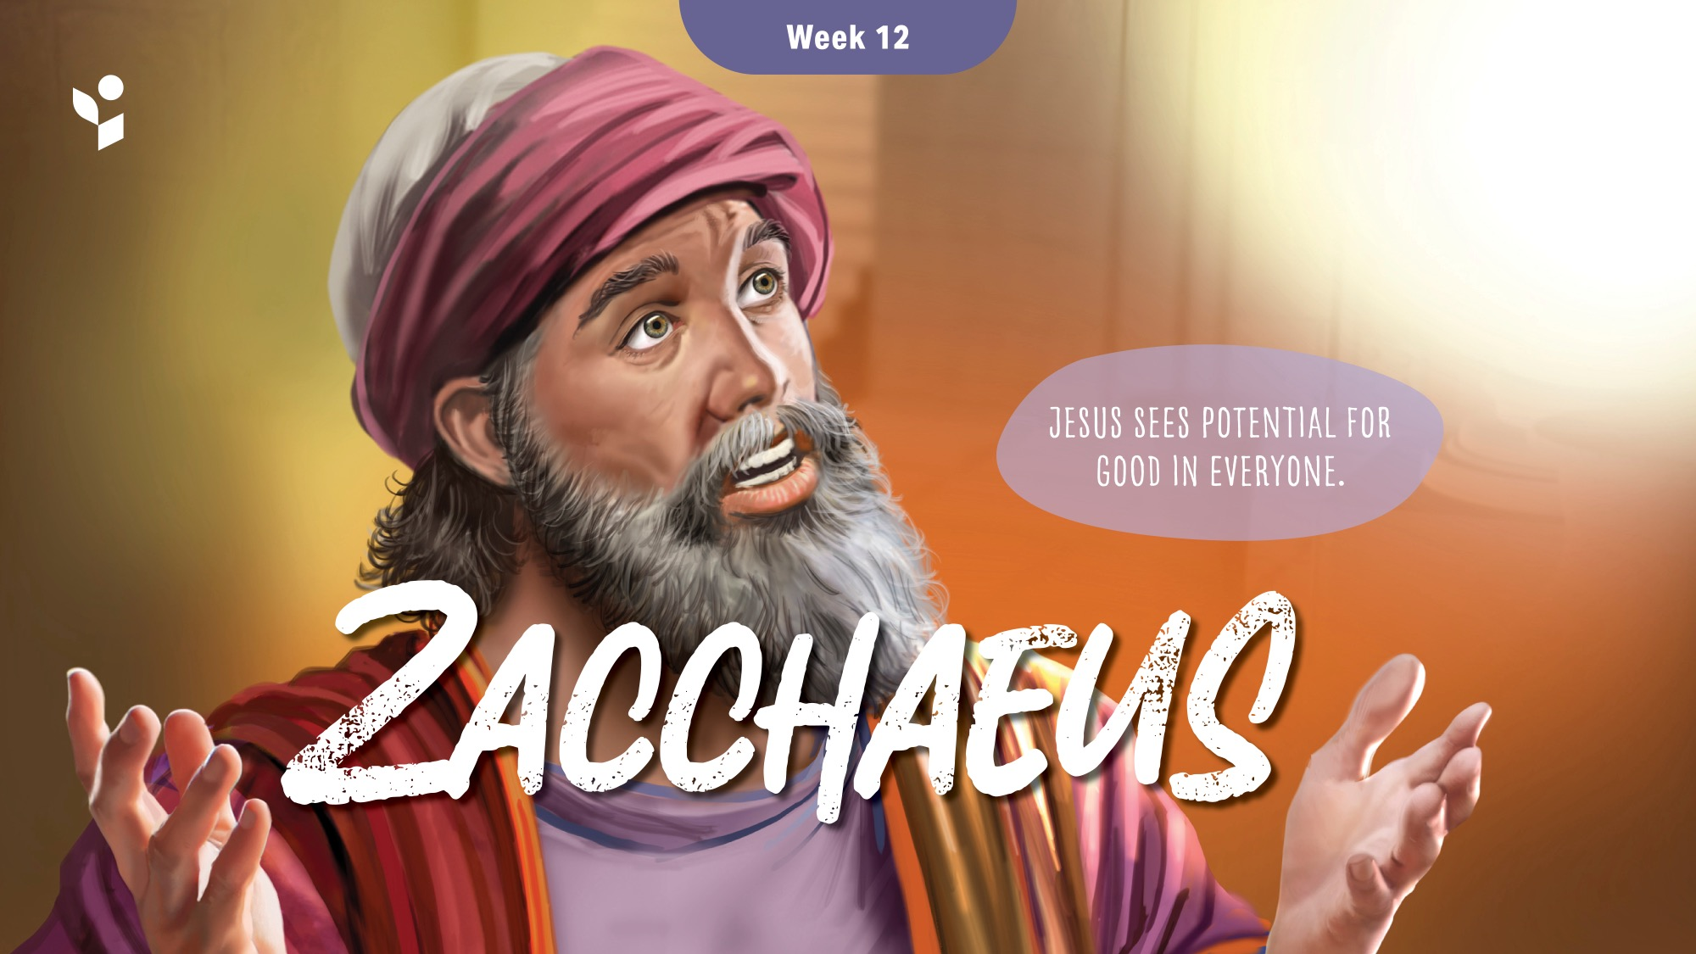

Slide 24
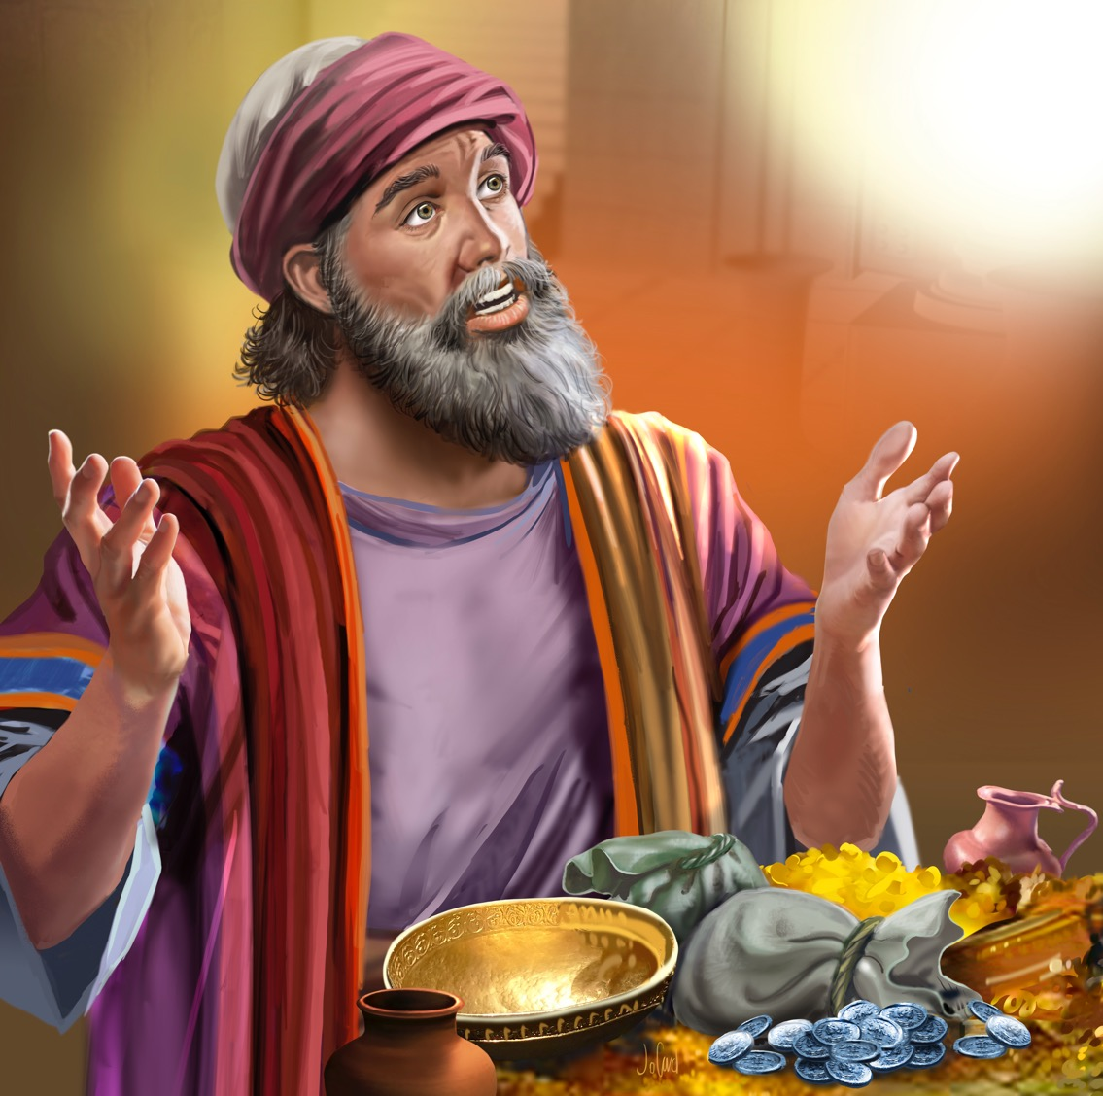
Illustration by Jo Card. Copyright © 2024 General Conference Corporation® of Seventh-day Adventists.

Slide 25
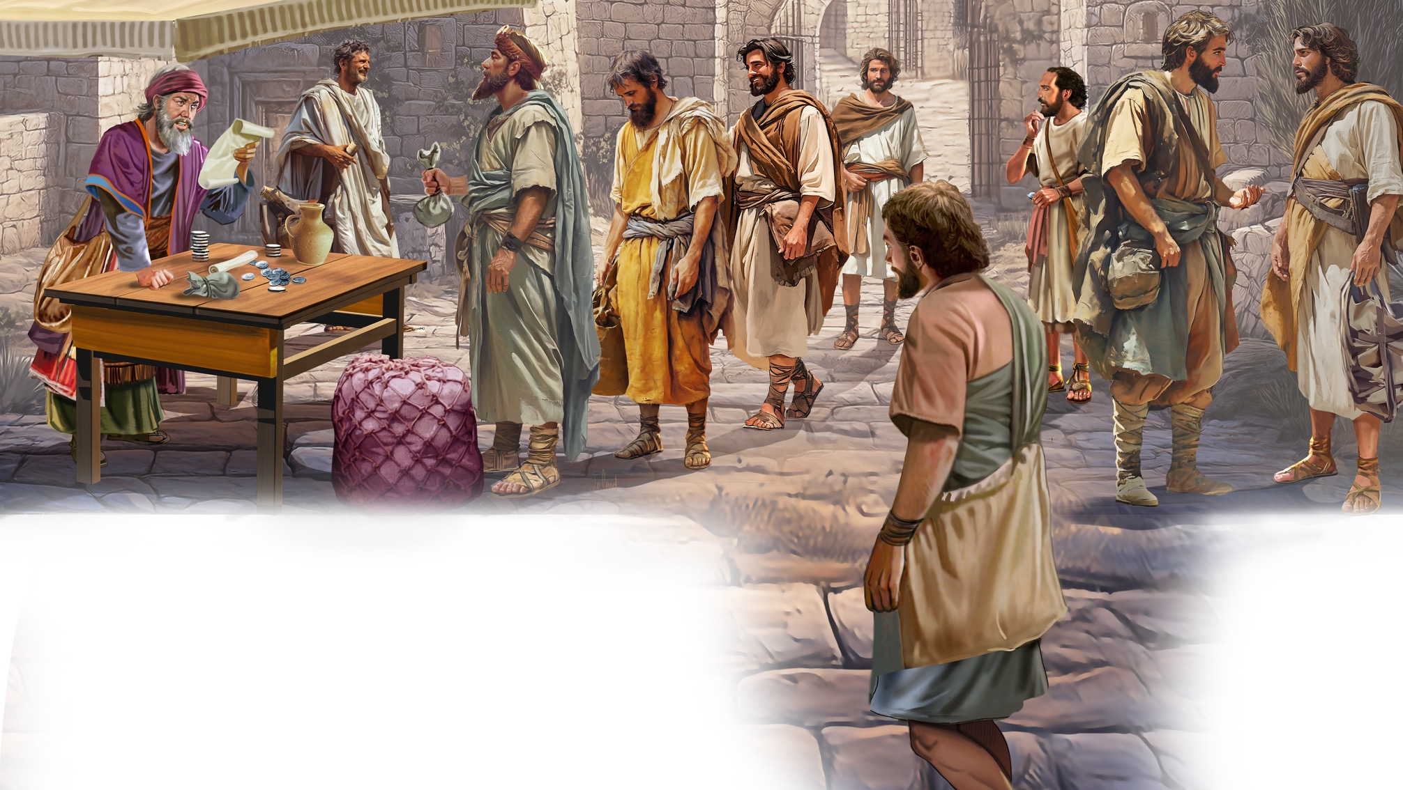
Illustration by Jo Card. Copyright © 2024 General Conference Corporation® of Seventh-day Adventists.

Slide 26
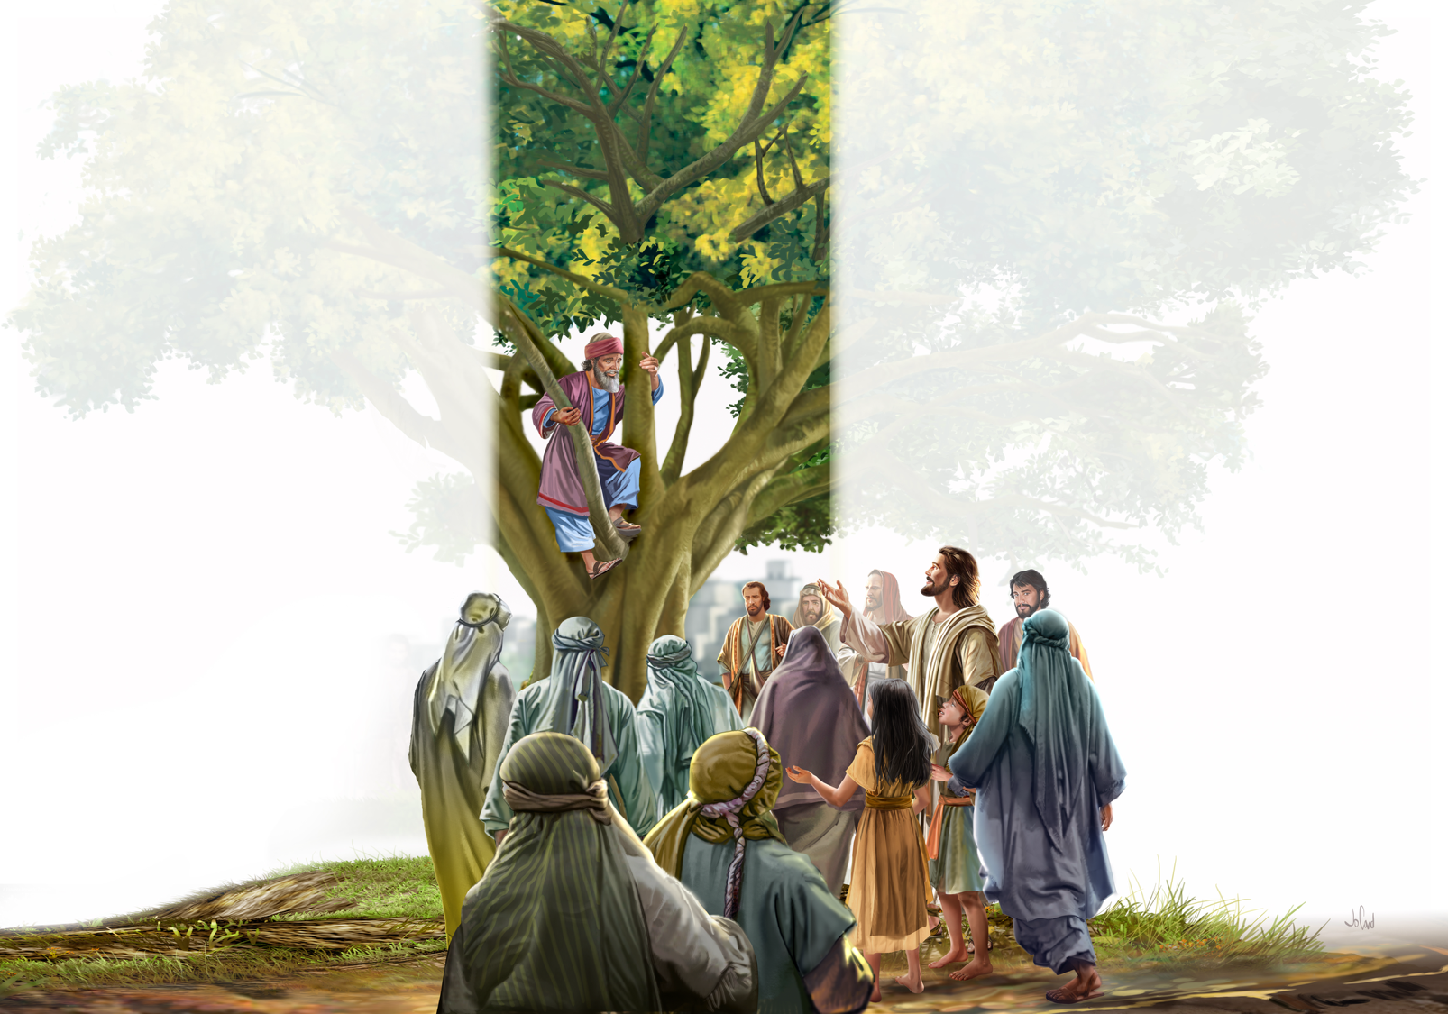
Illustration by Jo Card. Copyright © 2024 General Conference Corporation® of Seventh-day Adventists.

Slide 27
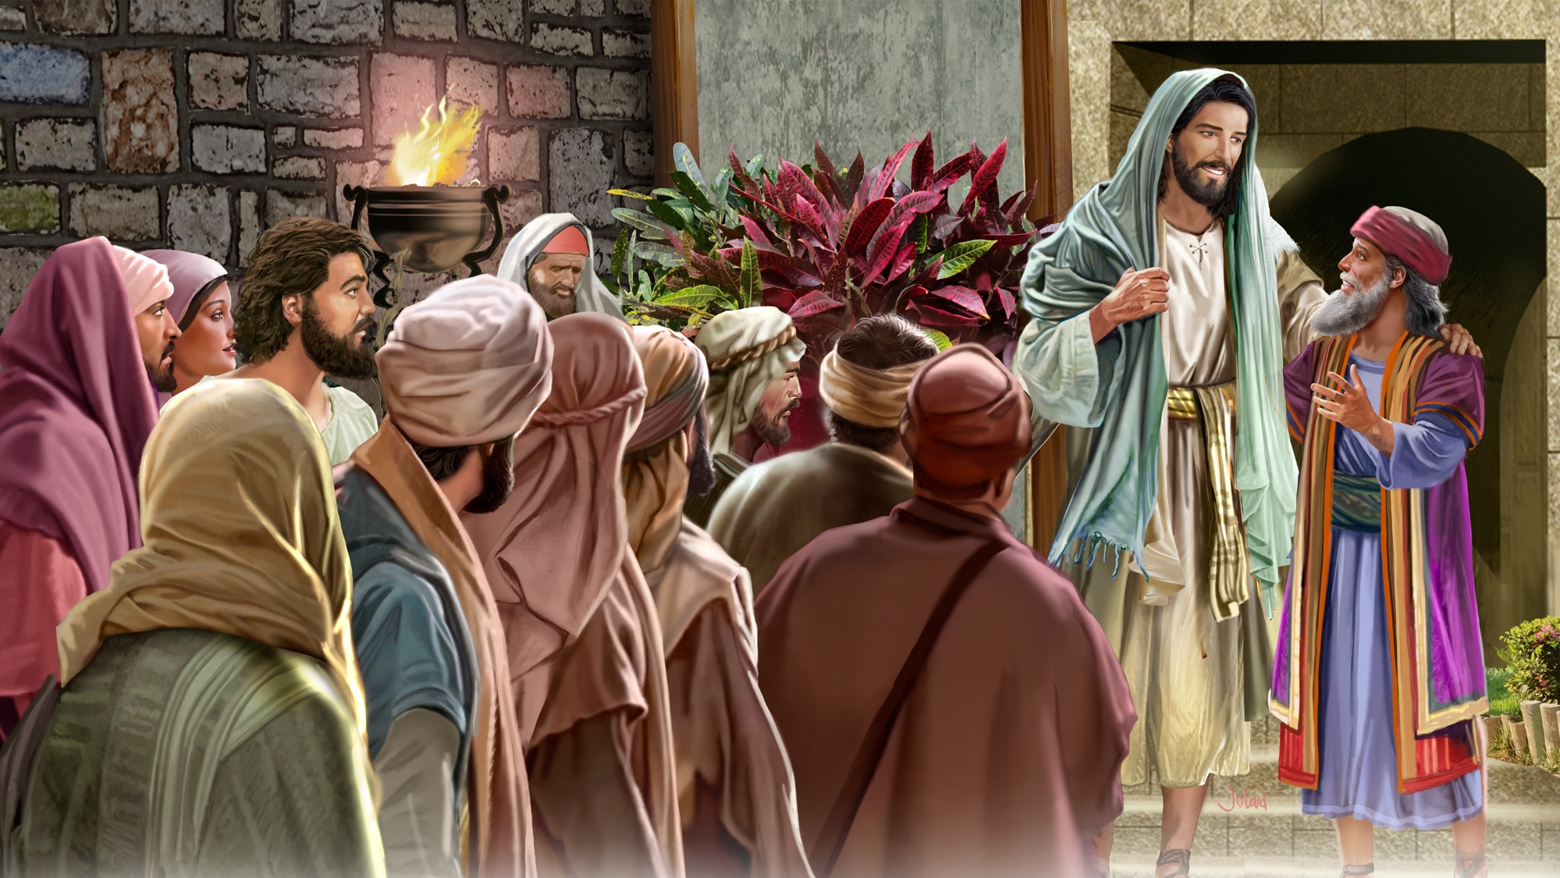
Illustration by Jo Card. Copyright © 2024 General Conference Corporation® of Seventh-day Adventists.

Slide 28
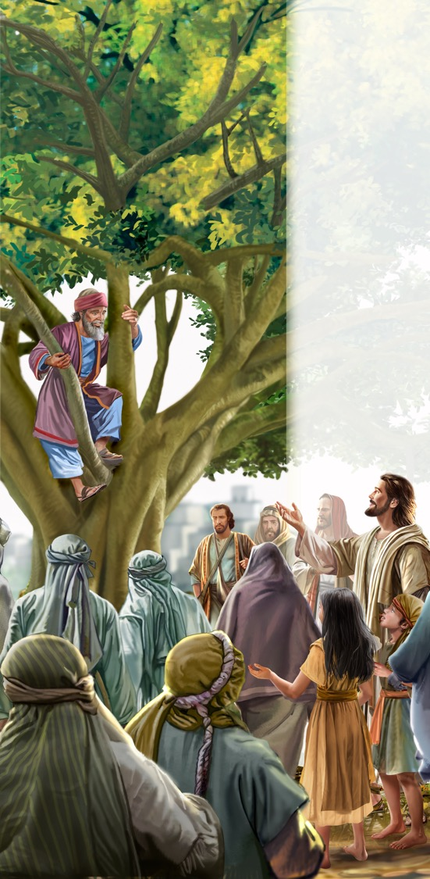
Zacchaeus Was a Wee Little Man (acapella)
BIBLE STORY
Zacchaeus was a wee little man,
A wee little man was he.
He climbed up in a sycamore tree
For the Lord he wanted to see.
And as the Savior passed that way,
He looked up in the tree.
And He said, “Zacchaeus,
You come down.
For I’m going to your house today.
For I’m going to your house today.”

Slide 29
UNPACK
THE STORY

Slide 30

CHARACTER CARDS

Slide 31
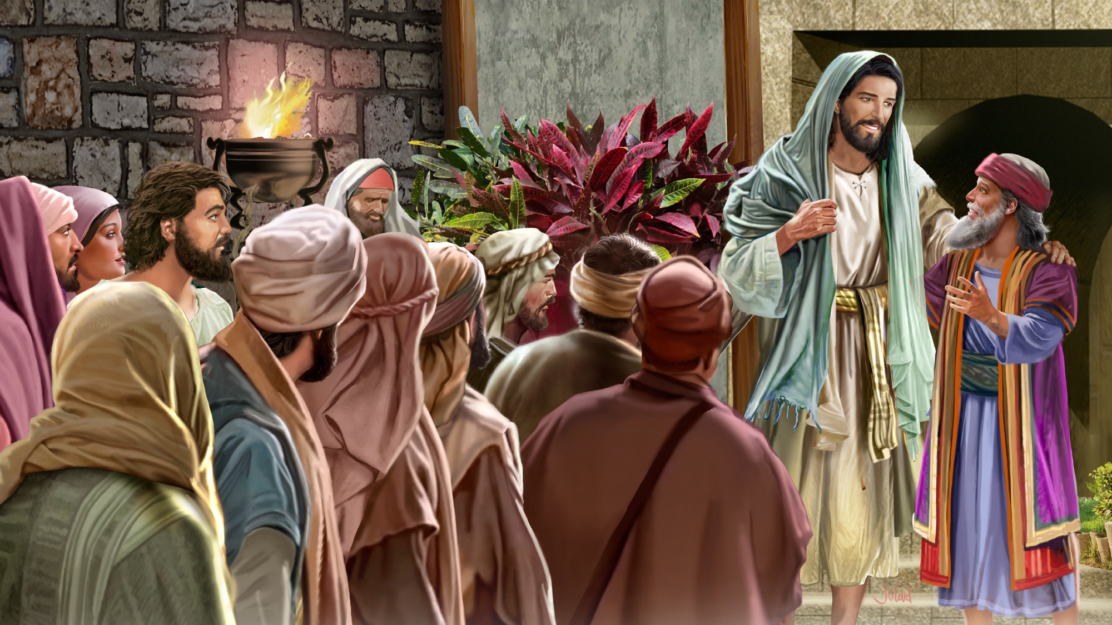
MEMORY VERSE
“. . . for the Son of Man has come to seek and to save that which was lost.”
Luke 19:10

Slide 32
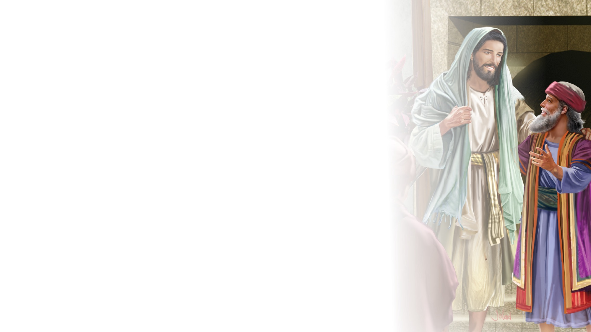
Luke 19:10
SCRIPTURE SONG
For the Son of Man
Has come to seek
And to save
That which was lost.
Luke 19 and verse 10.
(Repeat above)
"Luke 19:10" music by Rosie Smith, copyright © 2026 General Conference Corporation® of Seventh-day Adventists.

Slide 33

MISSION
STORY

Slide 34

CRAFT

Slide 35
MISSION
CHALLENGE

Slide 36
BIG IDEA
Jesus sees potential for good in everyone.

Slide 37

PRAYER
PRAYER

